Slide 1
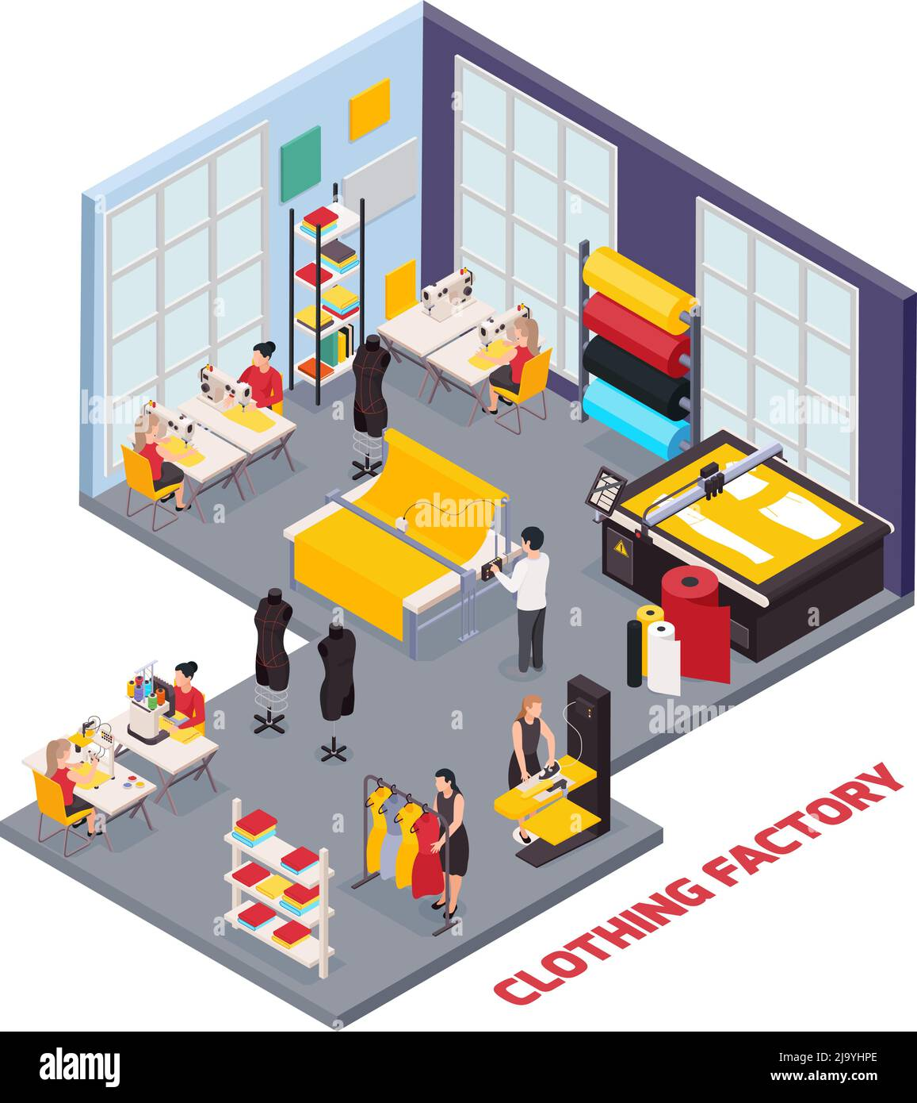
ManufacturiNG Project

Slide 2

Presented By :
Team Members ( Group - 6 ) :
Ms. Saloni Kailas Malpani
Mr. Uday Sanjay Mantri
Ms. Sayali Ramesh Mane
Ms. Mahek Sanjay Lalpuria
Ms. Priyanka D
Mr. Yunus Shaik
Mr. K.Padmanapan

Slide 3
INTRODUCTION :
Overview of the Garment Manufacturing Industry:
The garment manufacturing industry produces clothing and accessories through various stages, including design, fabric sourcing, cutting, sewing, and finishing. It operates globally and caters to diverse consumer preferences.
Purpose of the Project:
This project aims to innovate and improve garment manufacturing processes to enhance efficiency, sustainability, and competitiveness within the industry.
Goals and Objectives:
Enhance efficiency and reduce lead times.
Integrate sustainable practices throughout the supply chain.
Adopt innovative technologies to modernize operations.
Improve product quality and consistency.
Strengthen market competitiveness.
Prioritize worker welfare and safety.
Ensure customer satisfaction.
Drive sustainable growth and profitability.

Slide 4

PERFORMANCE METRICS :
KPI 1 : Manufacture Qty
Definition: The total quantity of items produced within a specific time frame.
Importance: Indicates the volume of output from the manufacturing process.
Visualization: Chart showing production quantity over time.
Insight: Tracking the manufacture quantity over time can reveal production trends, such as seasonality or periods of high demand.
Actionable Insight: Identify peak production periods to optimize resource allocation and scheduling.

Slide 5

KPI 2 : Rejected Qty
Definition: The quantity of items rejected during the manufacturing process due to defects or quality issues.
Importance: Reflects the effectiveness of quality control measures.
Visualization: Showing rejected quantity to total production.
Insight: Monitoring rejected quantity helps identify quality issues in the manufacturing process.
Actionable Insight: Investigate root causes of rejected items to implement corrective actions and improve quality control procedures.

Slide 6
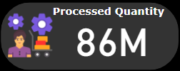
KPI 3 : Processed Qty
Definition: The quantity of items successfully completed through the manufacturing process.
Importance: Indicates the portion of production meeting quality standards.
Visualization: Chart illustrating the total processed quantity.
Insight: Comparing processed quantity to total production indicates the efficiency of the manufacturing process.
Actionable Insight: Streamline production processes and reduce cycle times to increase the proportion of processed quantity.

Slide 7

KPI 4 : Wastage Qty
Definition: The quantity of materials wasted during the manufacturing process.
Importance: Highlights inefficiencies in material usage and production processes.
Visualization: showing the breakdown of waste by material type.
Insight: Analyzing wastage quantity highlights inefficiencies in material usage and production processes.
Actionable Insight: Implement waste reduction strategies such as lean manufacturing principles or recycling initiatives to minimize wastage.

Slide 8
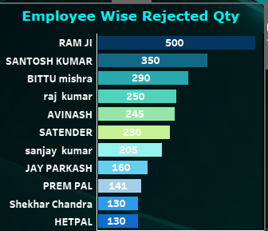
KPI 5 : Employee Wise Rejected Qty
Definition: The quantity of rejected items attributed to individual employees.
Importance: Identifies training needs or performance issues among employees.
Visualization: Stacked bar chart ranking employees by rejected quantity.
Insight: Identifying employees with high rejected quantities can indicate training needs or performance issues.
Actionable Insight: Provide targeted training and performance feedback to improve employee skills and reduce rejected quantity.

Slide 9
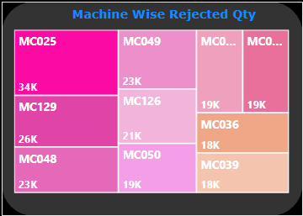
KPI 6 : Machine Wise Rejected Qty
Definition: The quantity of rejected items attributed to specific machines.
Importance: Helps optimize machine utilization and maintenance schedules.
Visualization: Treemap showing the machines with the highest rejected quantity.
Insight: Machines with high rejected quantities may indicate maintenance issues or inefficiencies in operation.
Actionable Insight: Schedule preventive maintenance and optimize machine utilization to reduce rejected quantity and downtime.

Slide 10
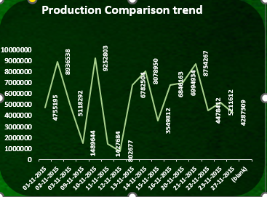
KPI 7 : Production Comparison trend
Definition: Analysis of production quantities over time to identify trends and patterns.
Importance: Provides insights into production fluctuations and seasonality.
Visualization: Line graph showing production trend over multiple time periods.
Insight: Analyzing production trends over time reveals patterns and seasonality in demand.
Actionable Insight: Adjust production schedules and inventory levels to meet fluctuating demand more effectively.

Slide 11
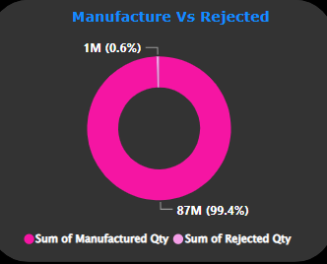
KPI 8 : Manufacture Vs Rejected
Definition: A comparison between total
manufactured quantity and total quantity rejected.
Importance: Evaluates the efficiency and quality of the manufacturing process.
Visualization: Donut chart comparing the percentages between manufactured and rejected quantities.
Insight: Comparing manufactured quantity to rejected quantity provides insights into the effectiveness of quality control measures.
Actionable Insight: Set quality targets and implement continuous improvement initiatives to reduce the proportion of rejected quantity.

Slide 12
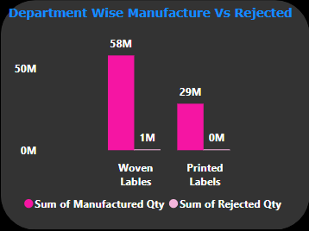
KPI 9 : Department Wise Manufacture Vs Rejected
Definition: Breakdown of manufactured and rejected quantities by department.
Importance: Identifies areas for improvement and allocation of resources.
Visualization: Clustered column chart comparing manufactured and rejected quantities by department.
Insight: Variations in manufacture and rejected quantities among departments indicate areas for improvement.
Actionable Insight: Allocate resources and prioritize quality improvement efforts based on departmental performance.

Slide 13
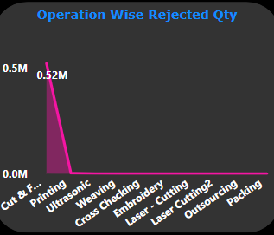
KPI 10 : Operation Wise Rejected Qty
Definition: Quantity of rejected items attributed to specific operations.
Importance: Identifies areas of improvement within the manufacturing process
Visualization: Stacked area chart showing the rejected quantity attributed to each operation.
Insight: Quantity of rejected items attributed to specific operations helps identify bottlenecks and inefficiencies in the manufacturing process.
Actionable Insight: Analyze and optimize operations with high rejection quantities to improve overall process efficiency and product quality.

Slide 14
SUMMARY :
At 92,52,803, 10-11-2015 had the highest Sum of Manufactured Qty and was 1,052.74% higher than 12-11-2015, which had the lowest Sum of Manufactured Qty at 8,02,677.
10-11-2015 accounted for 10.66% of Sum of Manufactured Qty.
﻿Across all 11 Emp Name, Sum of Rejected Qty ranged from 130 to 500.
Sum of Manufactured Qty and total Sum of Rejected Qty are positively correlated with each other.
Sum of Manufactured Qty and Sum of Rejected Qty diverged the most when the Department Name was Woven Lables, when Sum of Manufactured Qty were 57,679,298 higher than Sum of Rejected Qty.

Slide 15
OVERALL CONCLUSION : Driving Efficiency and Quality in Manufacturing Operations
Manufacture Quantity (Qty):
Monitoring the manufacture quantity provides insights into production volumes, enabling efficient resource allocation and scheduling to meet demand.
2. Rejected Quantity (Qty):
Analyzing rejected quantity helps identify areas for quality improvement, leading to reduced waste, improved product quality, and enhanced customer satisfaction.
3. Processed Quantity (Qty):
Tracking processed quantity indicates the efficiency of manufacturing processes and highlights areas for optimization to increase throughput and reduce cycle times.
4. Wastage Quantity (Qty):
Understanding wastage quantity allows for the identification of inefficiencies in material usage and production processes, facilitating waste reduction initiatives and cost savings.
5. Employee Wise Rejected Qty:
Employee-wise rejected quantity data aids in identifying training needs and performance issues, enabling targeted interventions to improve employee skills and reduce defects.

Slide 16
6. Machine Wise Rejected Qty:
Machine-wise rejected quantity insights facilitate maintenance scheduling and operational improvements to minimize downtime, enhance machine efficiency, and reduce rejection rates.
7. Production Comparison Trend:
Analysis of production comparison trends over time enables proactive adjustments to production schedules and resource allocation to meet changing demand patterns efficiently.
8. Manufacture Vs Rejected:
Comparing manufacture and rejected quantities provides a holistic view of production quality, guiding efforts to reduce rejection rates and improve overall process efficiency.
9. Department Wise Manufacture Vs Rejected:
Department-wise analysis highlights areas of variance in production and rejection quantities, informing resource allocation and improvement initiatives tailored to specific departments.
10.Operation Wise Rejected Qty:
Operation-wise rejected quantity insights pinpoint bottlenecks and inefficiencies in the manufacturing process, guiding targeted improvements to enhance operational efficiency and product quality.

Slide 17
THANK YOU

